Slide 1
Standard User – Collaboration: Perform a Review
February, 2013

Slide 2

Learning Objectives
Upon completion of this course you will be able to:
Understand the ECM Review Process
Review Task Properties
Open and Review a Contract
Enter a Comment for a Review

Slide 3
Review Process
A review process is highly collaborative and iterative, requiring multiple “passes” through the different reviewers.
Traditionally, this is accomplished using emails, phone calls, and meetings.
  The ECM system speeds up the reviews and processing of comments and helps the author manage this process.
After the author has requested a review by another user, the reviewer can:
  Review the task request
  Reassign the task to another User
  Decline the review task
  Review and edit the document as needed
  Include comments back to the Author and to other reviewers
  Indicate that they are finished reviewing the document.

Slide 4

Review Process, cont.
The system provides secure, single-user, on-line access to the document preventing simultaneous changes for different reviewers.
  Only one copy of a document can be open for editing at a time.
The reviewer is granted Contract Read permission on the contract.
Requesting a review will not prevent the document from continuing through the contract lifecycle stages.
  The document can be presented to external third parties even if all review comments are not received.

Slide 5
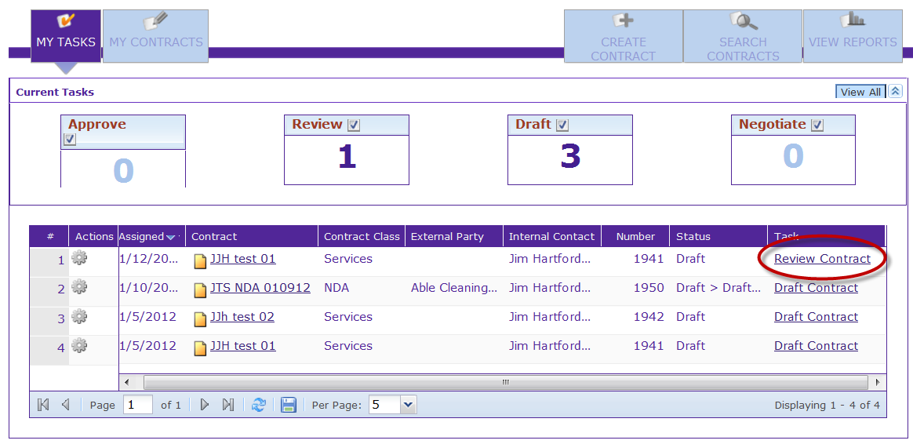
View the Review Task
As the Reviewer, the first thing you may want to do is look at the description of the review task to assess if you are the appropriate reviewer, and evaluate the amount of time that may be required to complete the review.
To Review a Contract, click the Review Contract hyperlink in the Task column of the My Tasks list.

Slide 6
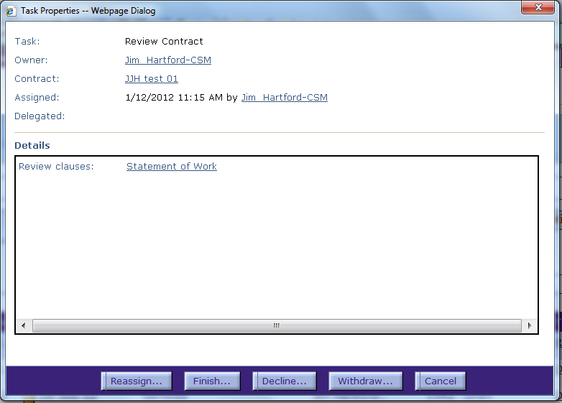
Review Task Properties
From the Task Properties dialog box, you can review the basic information about the request, such as the contract owner and date assigned, and look at the specific clauses, if any, that are part of the review request.
In the Details field, click on the clause name hyperlink.

Slide 7
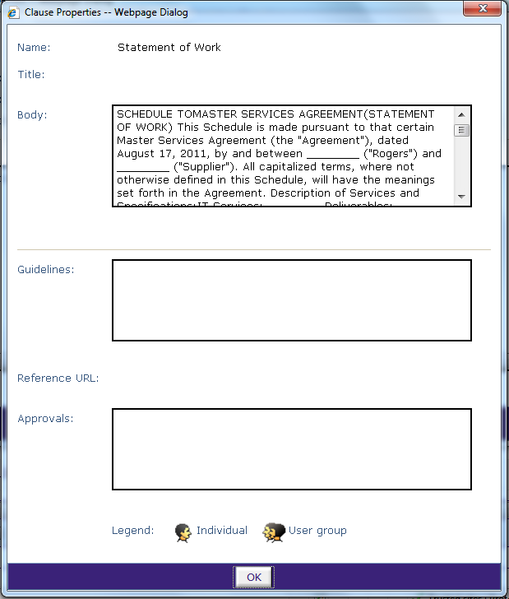
Review Clause Properties
Review the language in the Body of the clause.
Review the Guidelines that describe the general purpose for the clause.
Review the list of Approvals required for the clause, if any.
Click OK when done.

Slide 8

Close the Review Task
After reviewing the Task description and properties, you can determine if you need to:
  Reassign the review to another reviewer
  Indicate you are finished with the review task
  Decline the review request
  Withdraw the Review Contract Task from the recipient, or
  Cancel the Task Properties dialog box display and review the contract.
To continue in the process and review the contract in the Contract Editor, click the Cancel button to close the Task Properties dialog box.
  The Home Page is re-displayed.

Slide 9
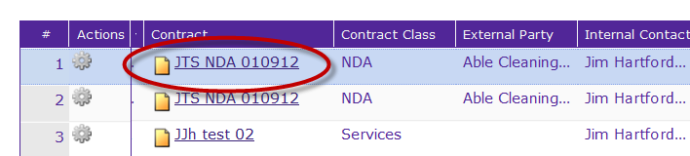
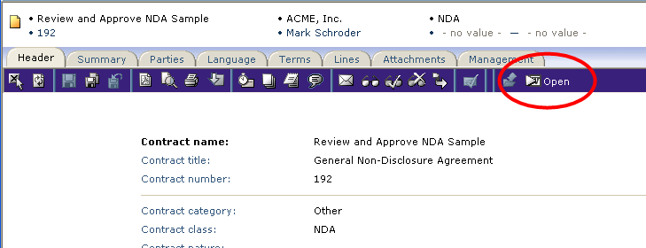
Open the Contract to Review
Click the contract name hyperlink to open the contract in the Contract Editor.
The contract is opened in the Header tab. If the contract would normally not be accessible to the reviewer (due to security), functions Withdraw, Present, and Execute, are not available, and only the Header and Management tabs.
Click the Open icon on the main, blue toolbar to open the contract in edit mode.
Or, click the Language tab to display the contract language.

Slide 10
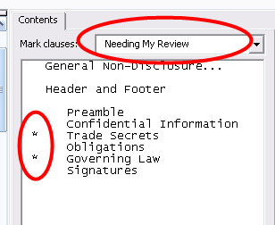
Review Marked Clauses
The clauses that need your review will be identified with an asterisk * in the Contents window at the far right of the screen.
Click on a clause name to go directly to that clause.

Slide 11
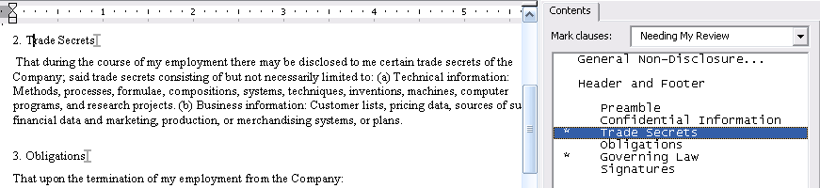
Review Text and Terms
Review the language and terms in the clause.
  You should be able to see all language and changes entered by the author as well as any previous reviewers.
Make changes as needed.
Click Save when done.
Click File > Exit to close the MS Word Editor and return to the Contract Editor.

Slide 12

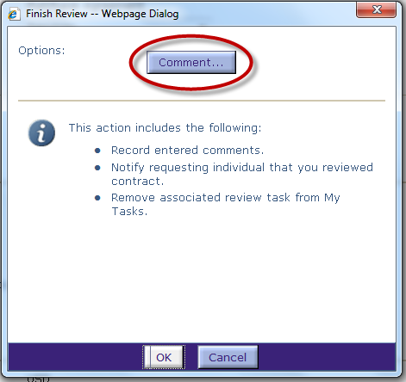
Finish the Review
From the Language tab, click the Finish Review icon on the main, blue toolbar.
To enter a comment, click the Comment… button.

Slide 13
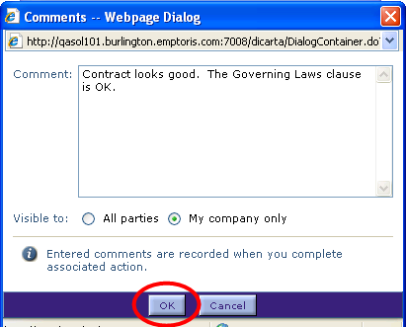
Enter a Comment
Comment: Enter your comment, providing as much detail as possible.
Visible to:
  All Parties: to make comments visible to internal AND external parties
  My company only: to make comments visible to internal parties only
Click the OK button when done.

Slide 14
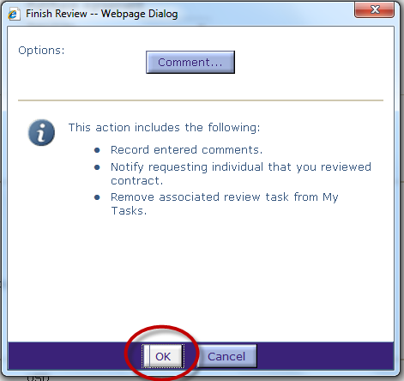
Finish Review
Click the OK button again to indicate you are finished reviewing the contract.
The contract will close and you will return to the Home Page.

Slide 15
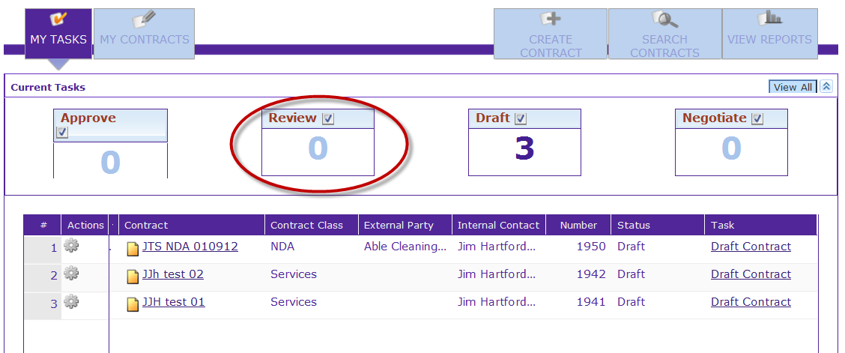
Review Task Complete
Notice that the Review Contract task has been removed from the My Tasks list.
An email will be sent to the requester to notify him/her that your review is now complete.

